Slide 1




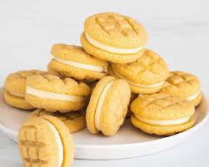

Please
join us
TIME
to
Thursday 11th December
9.15am
TALK
Come in for a coffee and an informal chat with the TAF team and the MHST (Mental health Support Team) will also be joining us to offer advice and support.
Jodie, Liliana or Jo
Family Support Workers on
01604 773910

