Slide 1
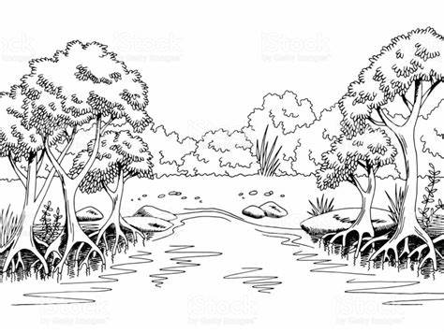
Key Stage 3 – Summer Term 2026-27
DIY SOS
My Communication
English
Cognition and learning
Maths
Cognition and learning
Understanding the
world
Cognition and learning
Explore the world
Social and emotional
PSHE
Science: Changing Materials
What is happening? By the end of the unit pupils will have explored mixing and separating a variety of materials.
What will happen if...? By the end of the unit pupils
will have explored a variety of solids, liquids and separation methods through mixing a variety of materials.
Properties of materials
What is it used for? By the end of the unit pupils will
be able to sort items according to their materials (with some elements of properties like hard/ soft)
Why is it made from that? By the end of the unit pupils will be able to use their understanding of materials to state why items are made from certain things.
Computing: Online safety – Content
Purpose: Managing online information
Privacy and Security.
Natterhub: Elements, Secure it, Question it, Learn it
Pupils will learn to use technology to help us in
different ways. They will learn to ask questions and
are open minded. They will learn to keep ourselves
safe online by using privacy settings and common
sense.
Computing Focus: Video Creation
Purpose: Pupils will develop their filming skills, in order to make videos and watch them back. They may be
able to plan and edit a finished video.
Self-Awareness:
Strengths and Challenges
Purpose: To be able to identify skills/ strengths
To recognise what skills I need for life (consider independence)
Support and safety - Being safe
Purpose: To be able to demonstrate awareness of inappropriate/ appropriate touch as well as personal space
To identify safe and unsafe items in the home.
World We Live In –
Community Awareness
Purpose: To know how to look after community and the environment.
SoSafe Links: Introduce ‘friends’ and associated rules (where ready)
Reinforce community workers.
DIY SOS
​Inform – Instructional text
Purpose: By the end of the unit, pupils will follow clear, step-by-step instructions to complete simple DIY tasks, helping them develop practical skills and confidence.
Entertain -Traditional tales
Purpose: By the end of the unit, pupils will enjoy traditional tales with a creative twist, linking to the theme of DIY SOS. They will explore stories where characters solve problems, fix things, and use their skills to help others, encouraging imagination, problem-solving, and engagement.
Number; place value and counting
Number; calculations
Geometry; Properties of shape inc pattern
Money and time
Religious Education
Judaism
Purpose: What did Moses do when God asked him to help the people?
Christianity
Purpose: Why do people celebrate Christmas?
Physical
PE
My Adult Life
Bikeability
Target games > Boccia
Transition and Travel – understanding the world
Visit local repair shops, DIY shops.
Charity shops-to buy to upcycle.
Computer exchange shops.
Explore links with school site supervisors.
Purpose
Pupils will engage and interact with the concept of shopping and being out in the community. They will learn about money exchange, product selection, and the importance of choice in purchasing goods; considering recycling and upcycling. They will create a repair shop to sell their items
My creativity
Expressive arts
Independence - My Living Skills
Art and Design - Thread – Colour – Recycled Art and Restoration Artist: Ha Schult
Purpose: To create a product from used materials.
Textiles: (Materials) Purpose: To alter clothing, add, dying, cutting ripping.
Music - Tempo and Dynamics
Music and emotions/energy. How we change this through how we are playing.
Purpose: Pupils will develop their understanding of how the speed (tempo) and volume (dynamics) of music can change its character and mood.
Cooking – Eggsciting Recipes – Using hand-tools and appliances. Preparation/cooking techniques (skills) Heathy Eating – Food safety and personal hygiene – Ordering – Changing materials
Purpose: Pupils will explore how eggs can change; scramble, fired, hard boiled, soft boiled. (Link with the school chickens)

