Slide 1
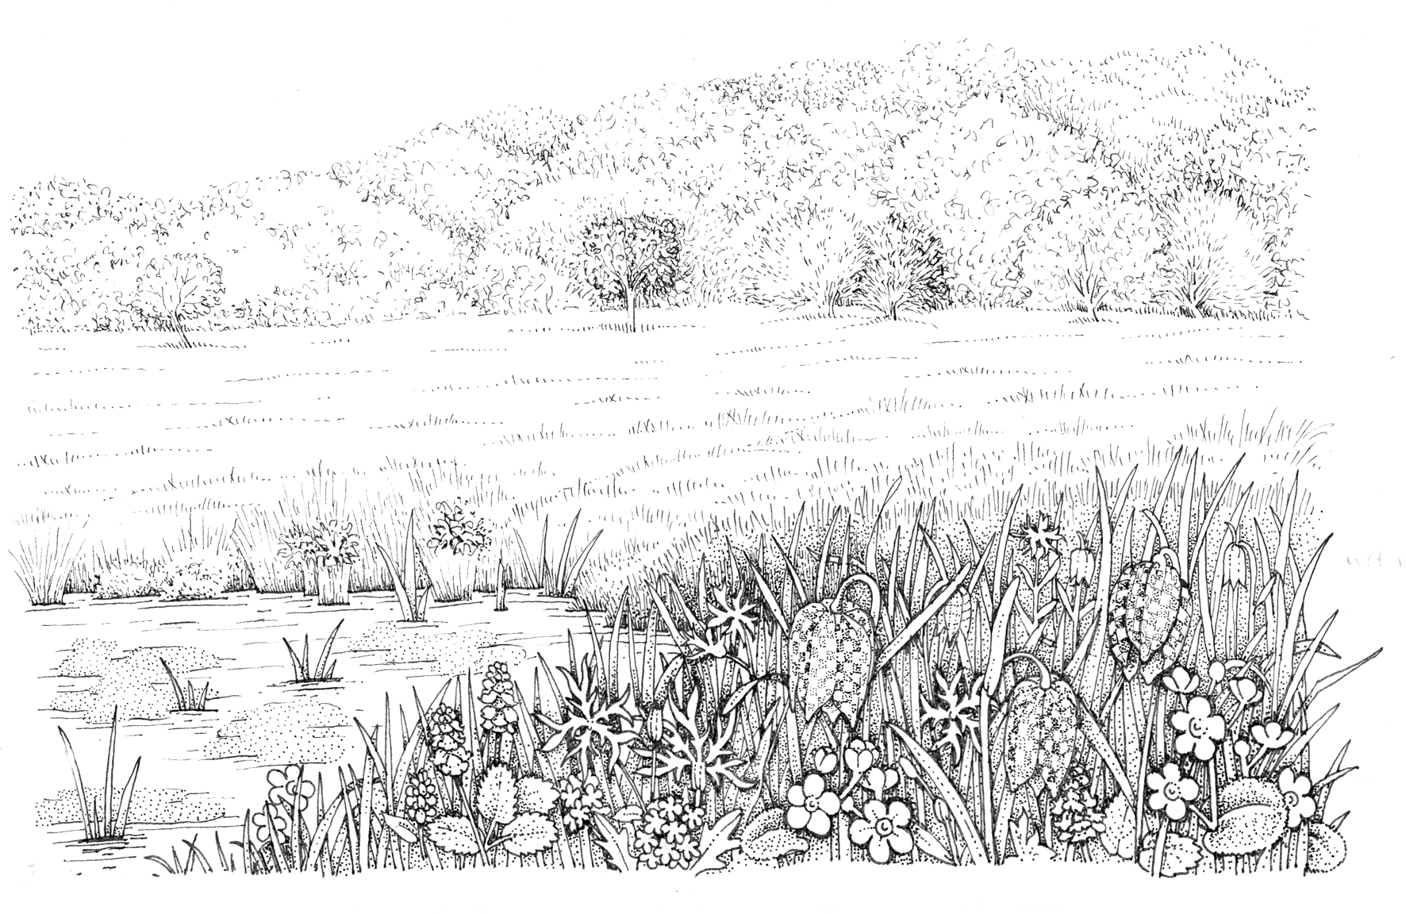
Primary 2 – Autumn Term 2026-27
Friends & Family
My Communication
Communication;
Literacy
Cognition and Learning;
Maths
Cognition and learning
Understanding the
world
Cognition and learning
Explore the world
Social and emotional
PSHE
To inform: Information Texts
Purpose: Pupils will be able to create a simple information text about themselves and make reference to the people in their family; learning about other family types as they go through.
To entertain: Narrative writing - Character thoughts and speech
Purpose: Pupils will be able to write or state what characters may be saying in a scene from a familiar story linked to Christmas.
Getting to Know Class
Number: Place, value and counting.
Measure: Length and height.
Number: Place, value and counting, calculation
Geometry: Shape and pattern.
Judaism
Purpose: What happens at Shabbat?
Properties of Materials:
What is it?
By the end of the unit the pupils will be able to identify objects/ materials and some of the uses for them.
Changes in Materials:
What is happening?
(Observing a change in material)
By the end of the unit pupils will have explored mixing and separating a variety of familiar materials.
Self Awareness
Strengths and Challenges
Purpose: To recognise my special interests and share them – to know what I can do, what I am good at.
So SAFE:
Intimate care – to know ‘helpers’ (as needed)
Know ‘People I know’
Self Care, support and safety in the community
Being Safe
Purpose: Dangers of Secrets
So SAFE:
Dangers of Secrets
Enrichment: Shabbat
Christianity:
Purpose: What gifts did the Wise men give Jesus?
Enrichment: Nativity Story
Changes in Living Memory – Family Tree
Purpose: Pupils will recognise themselves and family members: noting changes where appropriate.
Enrichment: Family open afternoon – opportunity to bring in grandparents/aunts/uncles to share in a family tree event.
Online Safety – Content
Purpose - Pupils will know that work they create belongs to them.
Computing Focus: Video Creation
Purpose: Pupils will develop their filming skills, in order to make videos and watch
them back. They may be able to plan and
edit a finished video.
My Adult Life
Physical
PE
Bikeability
Target Games
Boccia
Independence
Expressive arts
Independence
My Living Skills
Art and Design – Artist - Van Gogh Thread: Printing
Purpose: Create a print of starry night using a variety of printing techniques.
Music – Pulse – Pattern Little Sally Saucer
Purpose: Pupils will develop skills in playing to a pulse and starting to create rhythmic patterns in response to musical stimulus.
Cooking - Identify and use basic tools and equipment – for cutting and spreading, combining.
Purpose: Pupils will be able to share special foods and meals that they like and spend time making them
with their friends.
Recipe: Cakes – same recipe and process each week; can vary flavours.
Offsite visits, local community walks, road safety, transitions around school

